Slide 1

Bloodstain Pattern Classification
Devkumar Barot, Dharanidharan R
M.Sc. Applied Computer Science & Society, University of Winnipeg
Course: Digital Image Processing
Notes:
Good evening, everyone. We are Devkumar Barot and Dharanidharan R. Today, we’ll be presenting our project Study of Bloodstain Distribution which combines concepts of digital image processing with forensic analysis."

Slide 2
Introduction
This project aims to automatically distinguish between gunshot and impact bloodstain patterns using a structured computer-vision and machine-learning pipeline. Since traditional bloodstain interpretation can be time-consuming and subject to human bias, this system provides a more consistent and objective alternative.
The approach begins with preprocessing the image and segmenting the bloodstains through color-based detection. From these regions, the system extracts key features—such as droplet size, count, shape, and spatial distribution—that reflect the physical differences between gunshot and impact mechanisms.
A calibrated CatBoost classifier then uses these features to produce a reliable prediction, supported by a contingency method designed to handle very fine droplets commonly present in gunshot patterns.
Notes:
Today we’ll present a project that aims to take photos of blood spatter and automatically decide whether the pattern came from a gunshot or from a blunt impact. This is important in forensics because those two mechanisms produce different physical signatures — gunshots tend to produce a fine mist of many small droplets, whereas impacts create fewer, larger drops — and automating the task can speed casework and reduce subjectivity.
The system works like a motivated forensic pipeline: it first loads and standardizes images, uses color-based segmentation to find blood pixels, then computes a set of ‘expert’ numerical features (counts, sizes, shapes, spread, intensity, orientation). Those features feed a machine learning algorithm which is catboost classifier, and we calibrate the model’s output probabilities so the reported confidence actually matches real-world reliability. There’s also a built-in contingency path that specifically hunts for tiny droplets — a common failure mode — and re-evaluates the image when needed. Overall, the model is designed to be accurate, explainable, and useful in a forensic context.

Slide 3
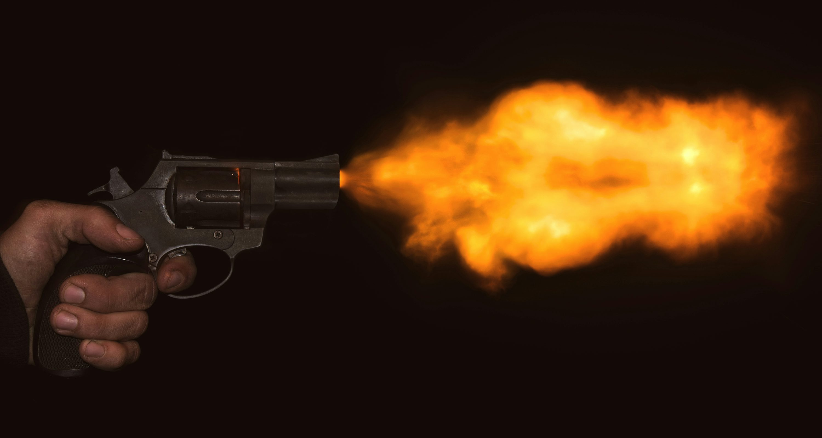
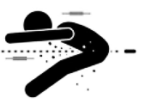
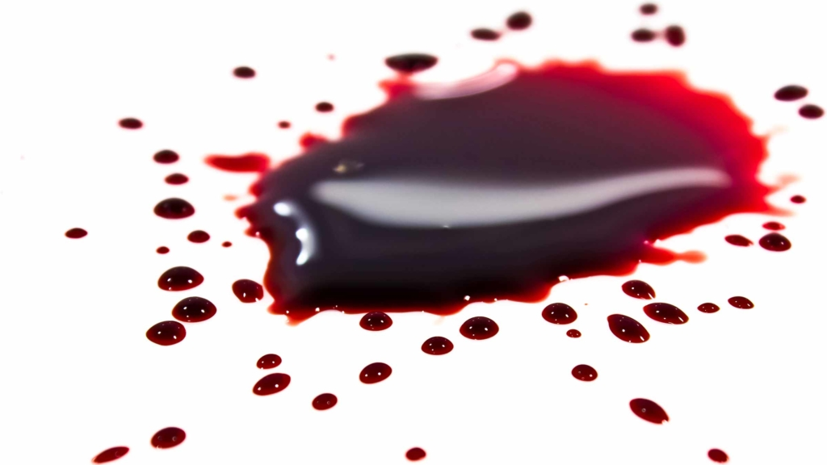
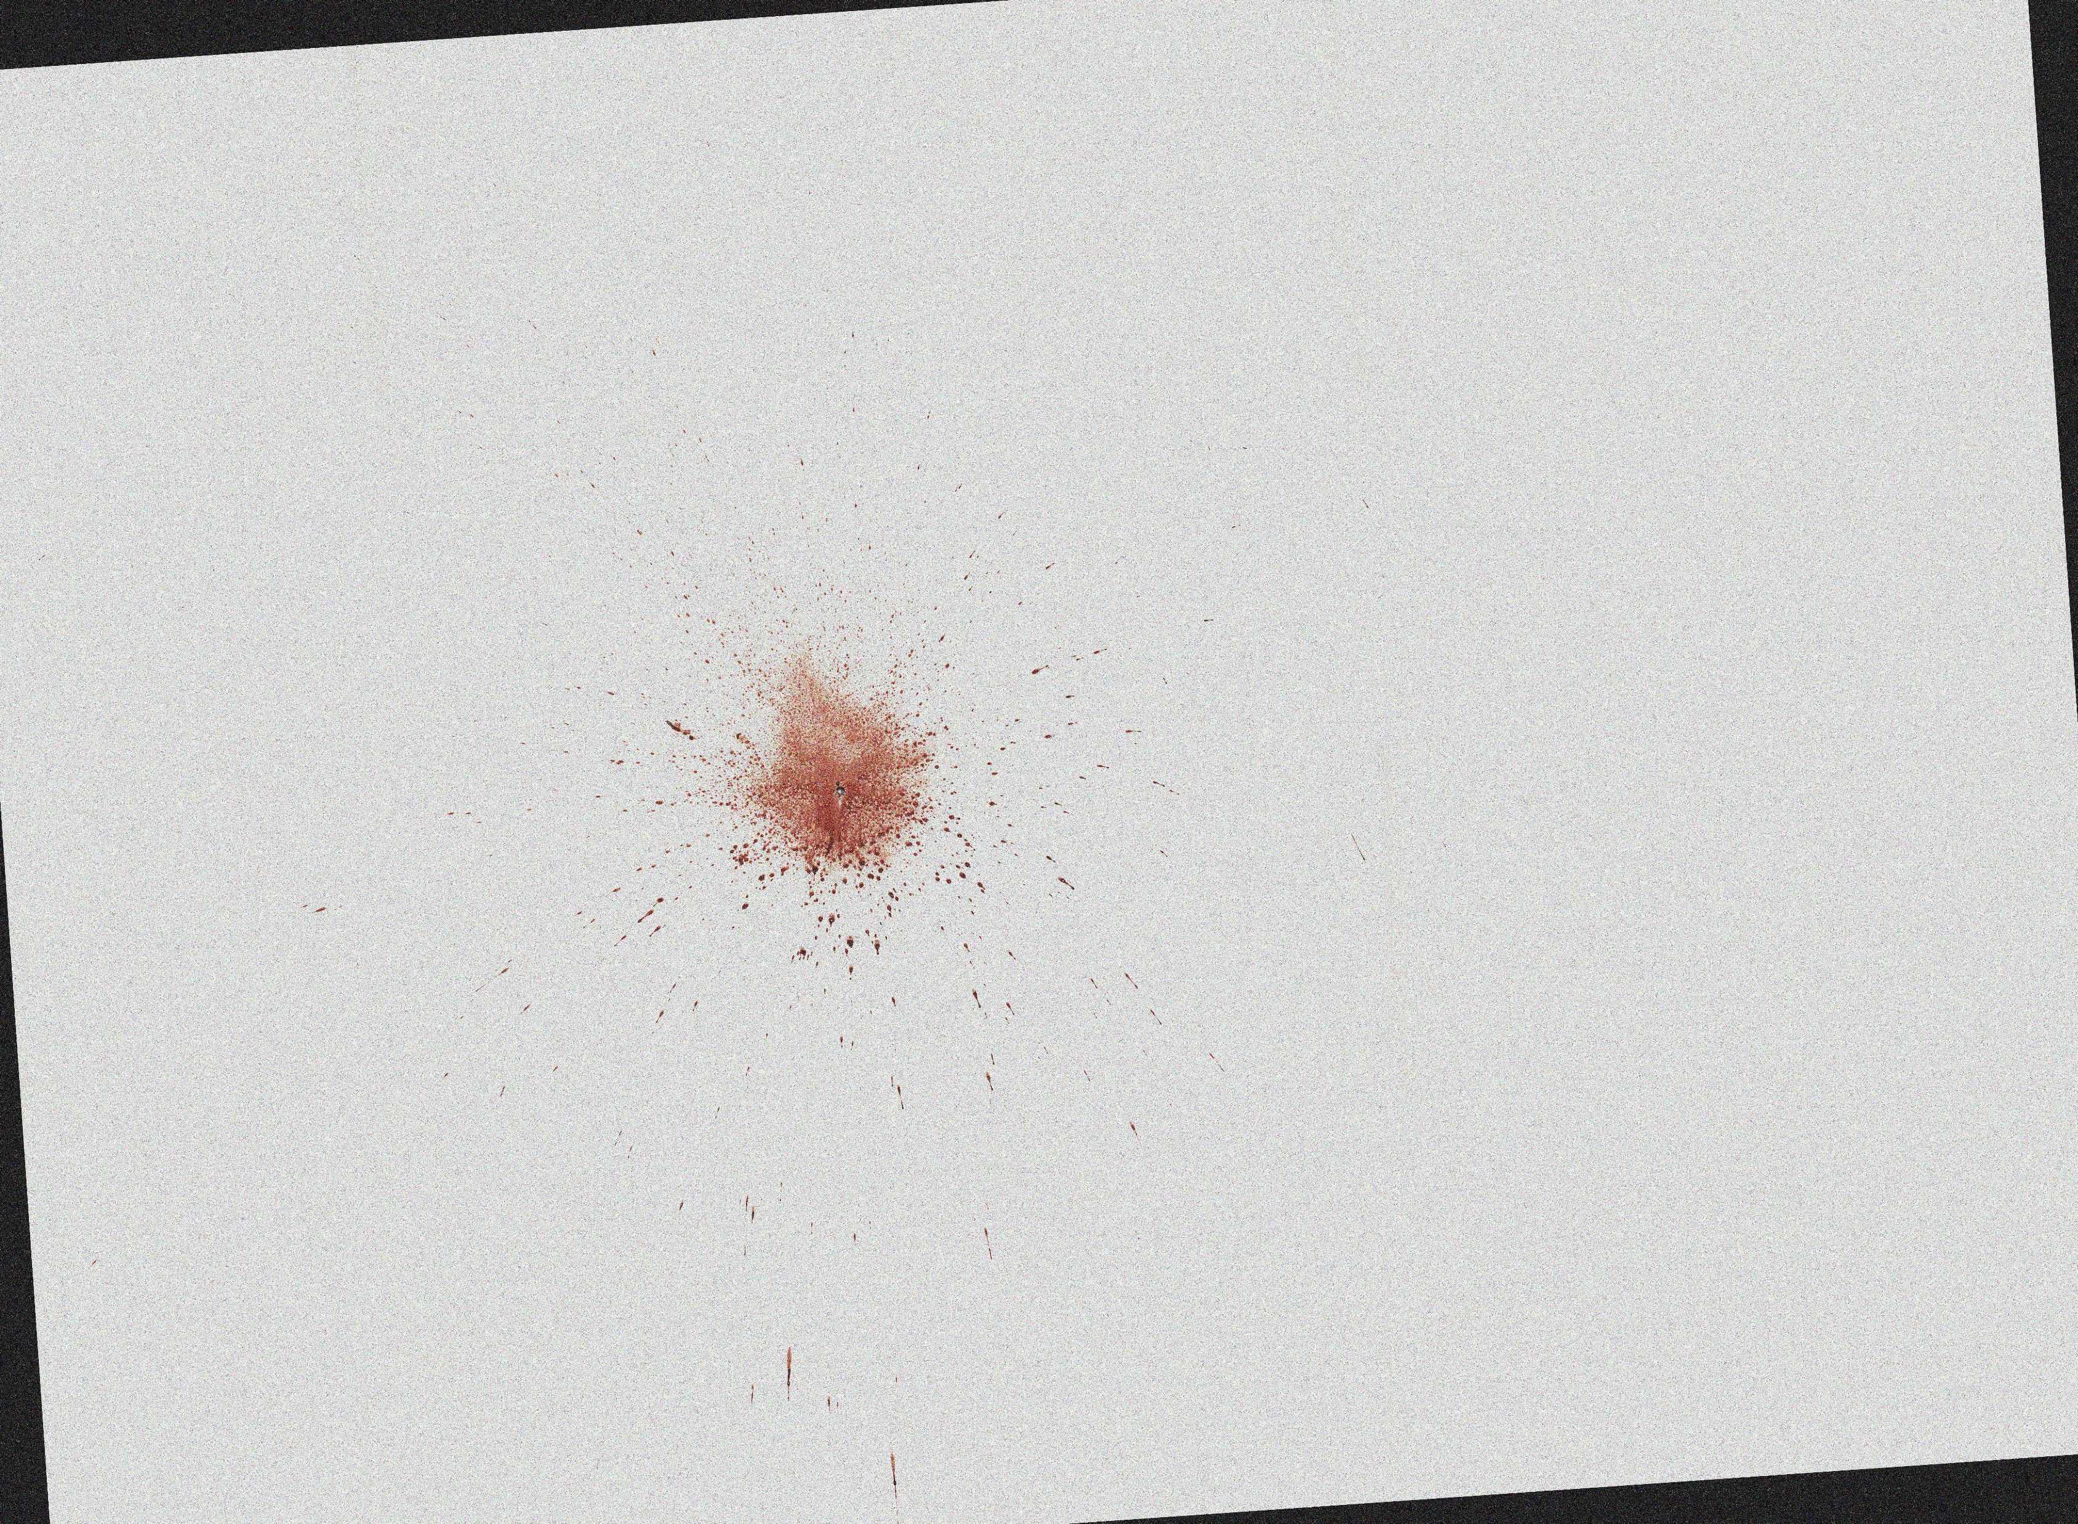
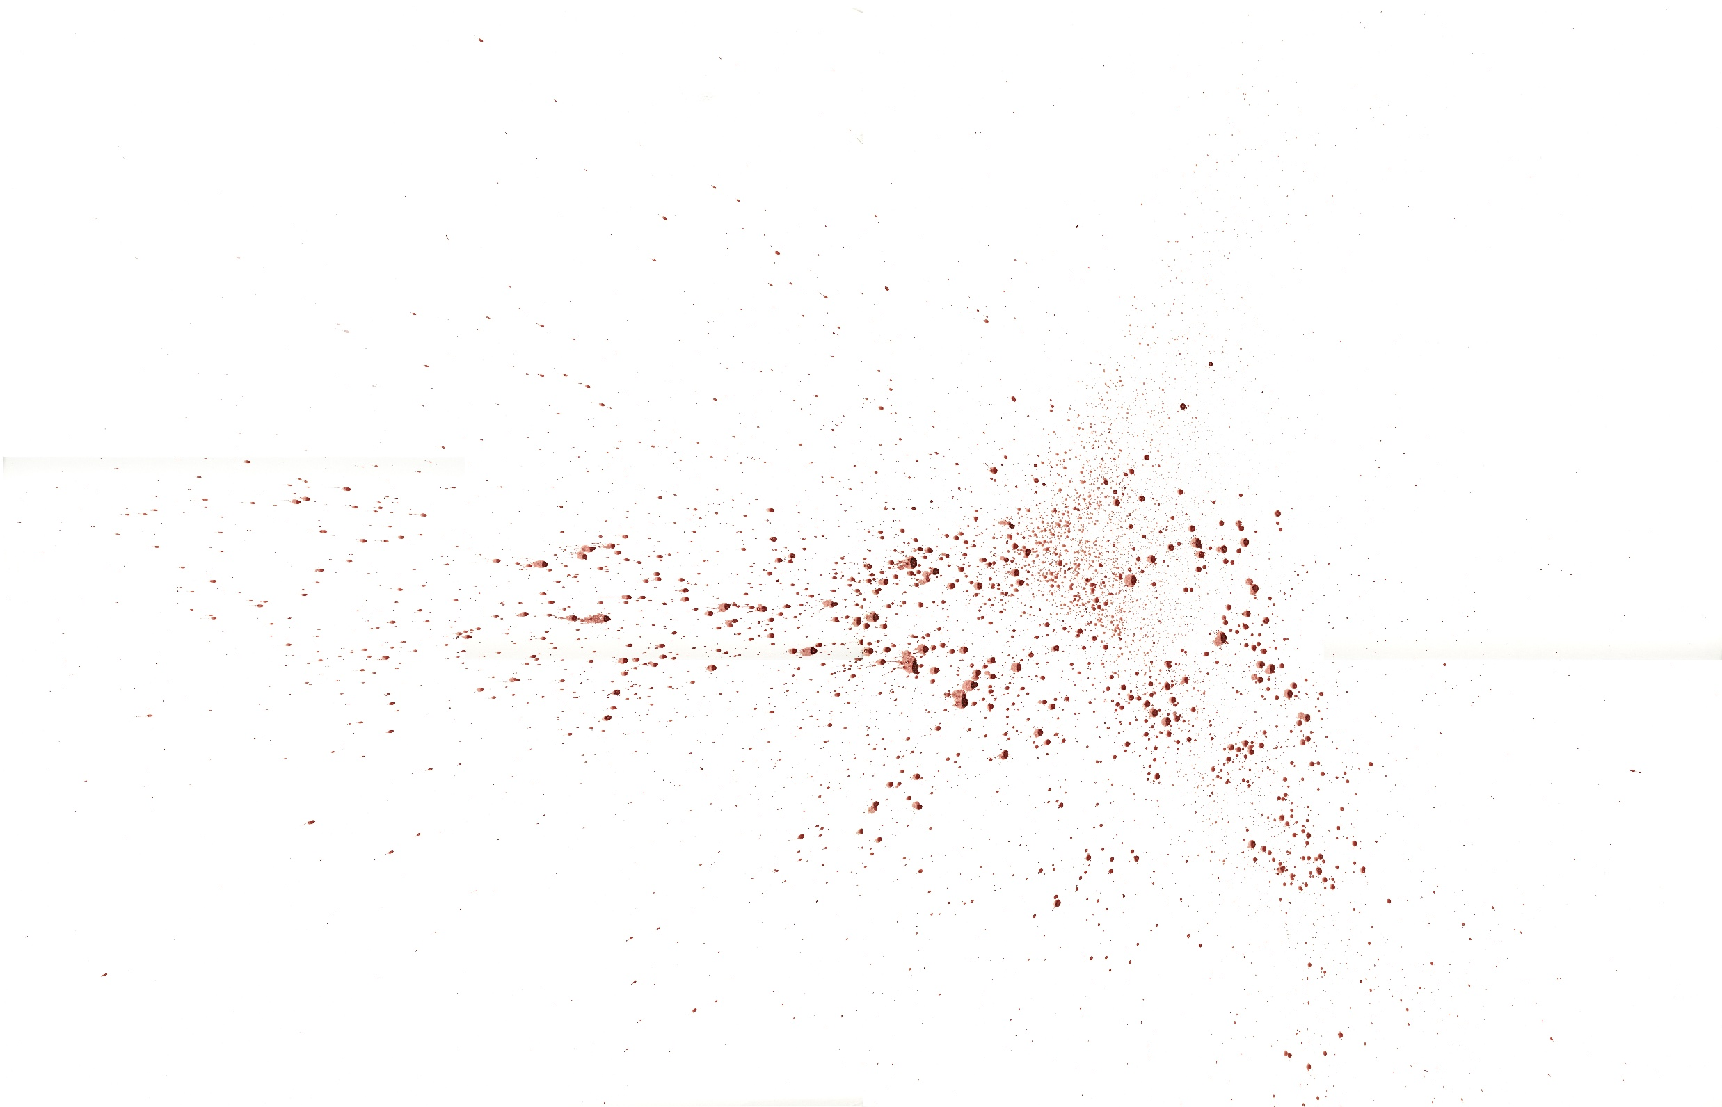
Gunshot Blunt Impact
Notes:
Gunshot Spatter (Left Side)
On the left, we have examples of gunshot spatter. Gunshot events involve high-velocity force, which breaks up the blood into extremely fine, mist-like droplets. These droplets are usually very small, very numerous, and tend to spread widely away from the source. In the bottom-left image, you can see this fine spray pattern — many tiny dots scattered over a large surface. This mist effect is one of the strongest indicators of a gunshot event.
Blunt Impact Spatter (Right Side)
On the right side, we see blunt-impact patterns. These come from lower-velocity forces, such as a strike with a fist or object. Because the force is less intense, the blood forms larger, more defined droplets, and there are fewer of them overall. In the images shown, you can notice the bigger, heavier drops and a more clustered distribution, which reflects the way the blood responds to impact forces.
The project extracts numerical features from the image that represent these characteristics, such as:
How many droplets exist
How large they are
How far they spread
How dense the pattern is
The machine-learning model learns these patterns and uses them to classify new images as either gunshot or impact.

Slide 4
Background & Literature Review
BPA uses size, shape, distribution of stains to infer mechanism.
Prior workflow: grayscale → threshold → connected components → ellipse features → RF/XGBoost (~0.93 accuracy).
Features: area, axes, orientation, impact angle, centroid, solidity.
Pattern summaries: global + local distributions.
Limitations of Past Work
Grayscale loses color/contrast, reducing segmentation accuracy.
Thresholding sensitive to lighting/background → poor generalization.
Rationale for Our Approach
Keep full detail via color-based segmentation (RGB+HSV).
Use richer forensic features beyond ellipses. CatBoost + probability calibration for stronger, reliable predictions.
Contingency path handles tiny gunshot droplets.
Notes:
In earlier bloodstain pattern studies, images were typically converted to grayscale, thresholded, and broken into connected components. Each stain was approximated with an ellipse, and features such as area, axis lengths, orientation, impact angle, and centroid position were used. These features were summarized globally and locally, then classified using models like Random Forest and XGBoost, achieving around 93% accuracy.
However, these methods rely heavily on grayscale images and simple thresholding, which lose important color and contrast details and often struggle under different lighting or backgrounds. This limits generalization.
Our approach keeps full color information using RGB and HSV segmentation, extracts a richer set of forensic-inspired features, and uses a more capable CatBoost model with probability calibration. We also include a contingency path for tiny droplets, making the system more robust and reliable for real-world bloodstain classification.

Slide 5
Input Image: Raw bloodstain photograph.
Loading & Preprocessing: Robust loading (OpenCV/PIL), fix transparency, standardize color, resize large images.
Main Segmentation: RGB + HSV thresholds to detect blood; noise removed via morphology.
Contingency Segmentation: Looser thresholds to capture tiny droplets (gunshot mist).
Feature Extraction: Compute droplet size, count, shape, spread, intensity, and color features.
CatBoost Classifier: Uses extracted features to distinguish gunshot vs. impact.
Probability Calibration: Isotonic + beta scaling for reliable confidence.
Final Output: Predicted class with calibrated confidence score.
Notes:
This slide shows our system workflow. We start with the raw bloodstain photo, which is preprocessed to standardize color and size. Then, we segment the blood using RGB and HSV thresholds, with morphological cleaning to remove noise. For very small or unclear stains, a secondary segmentation captures tiny droplets, like those from gunshot mist.
From these masks, we extract features such as droplet size, shape, spread, and intensity, which are fed into a CatBoost classifier to distinguish gunshot from impact patterns. Finally, we calibrate the model’s probabilities and output the predicted class with a confidence score.

Slide 6
About Data & Preprocessing
Data Type: .jpg file
Images collected under controlled indoor conditions with consistent lighting
Surfaces: Coated/white panels to enhance stain visibility
Two categories for images:
Gunshot images: 400+
Impact images: 450+
Stratified 80/20 split for balanced training and testing
Preprocessing Outputs
Standardized resized image
Blood segmentation masks
Feature vector (≈80+ features) per image
Stored in a structured CSV dataset with labels
Notes:
“This project uses a curated dataset of gunshot and impact bloodstain images captured under controlled indoor conditions. The stains were photographed on coated panels to keep the patterns clear and consistent. We split the data using an 80/20 stratified approach to maintain class balance. Each image is then resized, segmented, and converted into a feature vector containing over 80 expert-designed measurements. These feature vectors, along with labels, form the final CSV dataset used for training and evaluation.”

Slide 7
Blood Segmentation
1. Main Segmentation Path
Uses combined RGB and HSV thresholds to detect blood-colored pixels.
Removes noise and small artifacts using morphological operations (opening, closing).
Produces a clean, stable mask for normal-sized stains.
2. Contingency Segmentation Path
Triggered when the stain area is small, sparse, or unclear.
Uses looser, more permissive thresholds to capture tiny micro-droplets.
Essential for detecting gunshot mist, which standard thresholds may miss.
3. Final Blood Mask
Chooses the better of the two masks based on coverage and consistency.
Ensures both large stains and fine droplets are captured.
Notes:
In this step, the goal is to isolate only the blood regions from the input image so that we can analyze the stains accurately. The system uses two segmentation paths.
The main segmentation applies combined RGB and HSV color thresholds to detect blood-colored pixels. After that, morphological operations clean up the mask by removing noise and small artifacts, giving us a stable outline of the stains.
If the system finds that the stain area is too small or unclear, it activates a contingency segmentation. This second path uses looser thresholds to capture very tiny droplets that the main mask might miss. These micro-droplets are especially important for identifying gunshot mist patterns.
Finally, the system compares both masks and selects the one that best represents the blood regions. This ensures that both large stains and fine droplets are accurately captured before moving on to feature extraction.

Slide 8
Feature Extraction
1. Basic Size & Coverage
2. Count & Size Distribution: Counts stains and analyzes their size patterns (means, ratios, small vs. large stains). Gunshots → many tiny drops; impacts → fewer, larger stains.
3. Shape & Passive-like Features: Evaluates roundness and circularity to detect passive-type stains, which are more common in impact patterns.
4. Spatial Distribution: Analyzes how stains are spread (distance percentiles, core vs. outer density). Gunshots spread wider; impacts cluster near the source.
5. Intensity Distribution: Uses grayscale statistics to separate heavy, dark deposits from lighter, mist-like droplets.
6. Elongation & Orientation: Measures how stretched stains are and whether they follow a directional trend (impact angle cues).
7. Clustering / Neighbor Features: Examines spacing between stains; gunshot mist forms dense clusters of tiny droplets.
8. Color Features: Includes mean R/G/B and HSV values (e.g., red dominance) to capture details lost in grayscale-only approaches.
Notes:
In this slide, I’ll explain how we organize all of the expert features used for classification. The first group is Basic Size and Coverage Features, which measure how much of the image is covered by blood and how widely the stains spread. This gives an overall sense of whether the pattern is dominated by large deposits or many small droplets.
Next are Count and Size Distribution Features, where we identify every individual stain and analyze its size. Gunshot patterns tend to show many tiny droplets, while impact patterns usually contain fewer but larger ones, so this category is highly discriminative.
The third group is Shape and Passive-like Features, which evaluate how round, circular, or drip-like each stain is. Impact events often create larger, more circular stains compared to gunshot mist.
We also compute Spatial Distribution Features to understand how stains are positioned—whether they’re tightly grouped or widely dispersed across the image.
The fifth group is Intensity Distribution Features, which examine grayscale levels inside the blood regions. These help differentiate heavy, dark deposits from lighter, mist-like stains.
Next, Elongation and Orientation Features capture how stretched the droplets are and whether they share a directional trend.
We add Clustering Features, which measure the spacing between stains; gunshot mist typically forms dense clusters.
Finally, we include Color Features, such as red dominance and saturation, which capture details lost in earlier grayscale-only methods.
Together, these eight categories form a comprehensive feature set that represents both the physical and visual characteristics of bloodstain patterns.

Slide 9
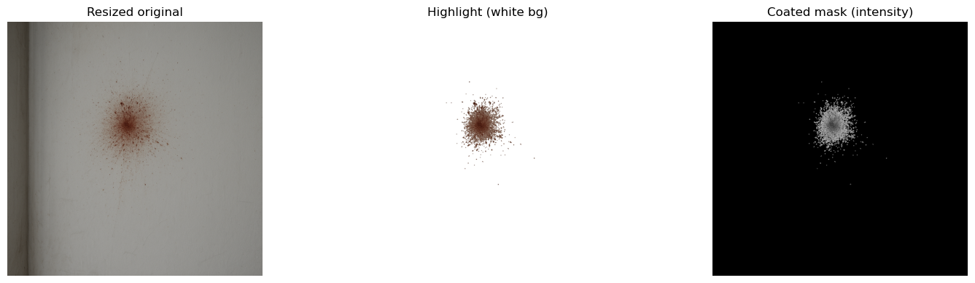
SAMPLE TEST FOR SEGMENTATION TESTING AND FEATURE EXTRACTION
Notes:
This slide shows a sample test of how our system processes a bloodstain image. On the left is the resized original, which ensures every image is handled at a consistent scale. The middle image is the highlighted version on a white background, helping us visually confirm the detected blood regions. On the right is the coated mask, the final binary mask used for feature extraction, where white pixels represent blood.
Below is the feature table generated from this mask—values such as blood pixel count, coverage, and intensity statistics. These form the expert features used by the classifier.
You’ll notice the stain is darker at the center. That’s because the central impact zone contains the highest volume of blood, creating a thick deposit that absorbs more light. The smaller outer droplets appear lighter. This natural contrast is useful for both segmentation and feature extraction.

Slide 10
Model Training, Evaluation & Calibration (CatBoost)
Training Setup:
CatBoost classifier trained on expert features.
Stratified 80/20 train–test split for balanced evaluation.
GPU-accelerated training with class balancing.
Performance Metrics:
Accuracy: 0.95
Gunshot: Precision 0.94, Recall 0.95
Impact: Precision 0.96, Recall 0.95
Confusion Matrix:
Gunshot correctly predicted: 83
Impact correctly predicted: 89
Total misclassifications: 9
AUC Scores:
Raw AUC: 0.9936
Calibrated AUC: 0.9936 (no loss after calibration)
Calibration Method:
Platt scaling (logistic regression) applied on gunshot probability.
Outcome:
High-accuracy, stable classifier with calibrated and interpretable probability outputs.
Notes:
This slide summarizes our CatBoost model performance. After an 80/20 stratified split, the classifier achieved 95% accuracy, with both gunshot and impact patterns showing strong precision and recall around 0.94 to 0.96. The confusion matrix confirms consistent performance, with only a few misclassifications out of 181 test images.
We then applied Platt scaling to calibrate the gunshot probability. The AUC remained extremely high at 0.9936, both before and after calibration, which shows that calibration improved interpretability without hurting performance. Overall, the model is accurate, stable, and produces reliable probability scores.

Slide 11
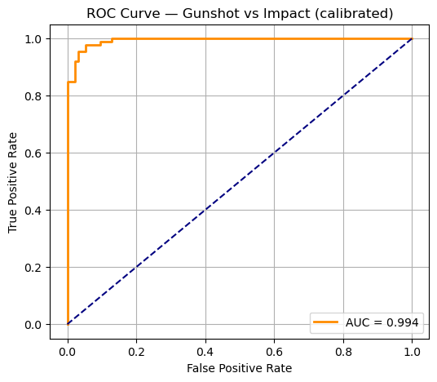
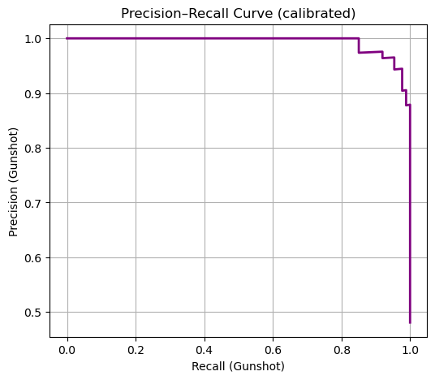
Advanced Performance Diagnostics

Slide 12
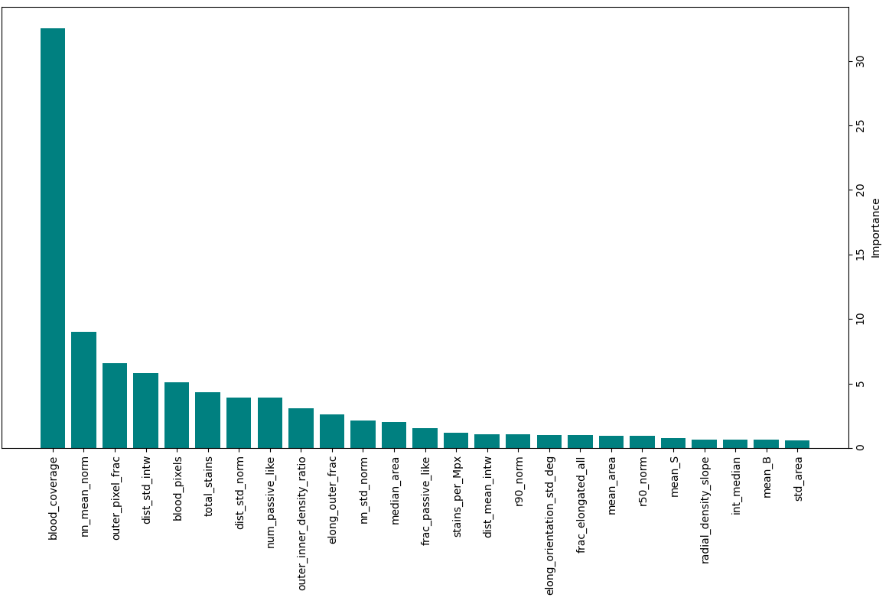
Top 25 Important
Features
- CatBoost

Slide 13
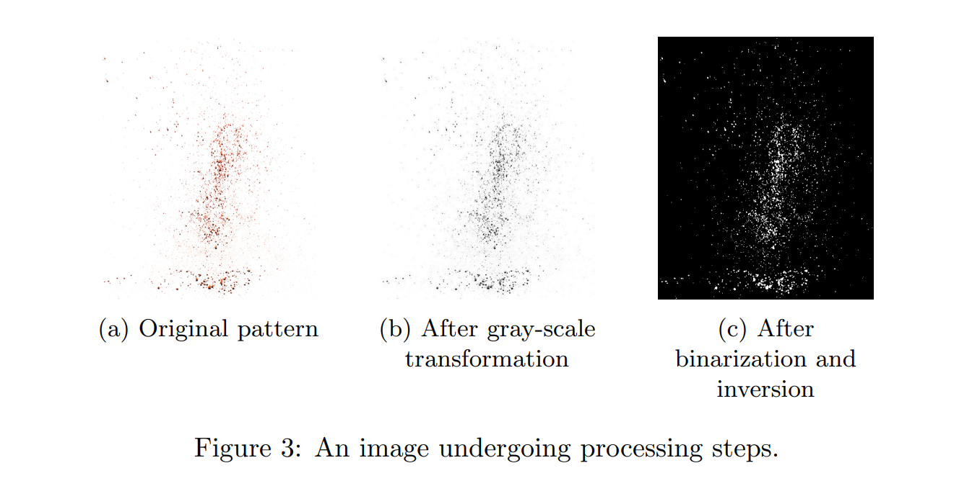
Variant A - Image processing step
Note : HSV-first masks retain chroma, improving separation of true blood from shadows/textures and helping with overlaps exactly where generalization was challenging in prior work.

Slide 14
Timeline
Week 1-4: Data collection
Week 10:
Re-working on project(from initial)
Week 6-8:
Variant B
Week 14-15:
Presentation and Report
Week 5:
Feature aggregation + RF/XGB baseline
Week 9:
Rigorous CV & held-out evaluation, SIS, error analysis
Week 11-13: Collecting more data, Github (pull/push), CatBoost Classifier, Arg-Max, Re-Evaluting

Slide 15
References
Y. Li and W. Shen, “From images to detection: Machine learning for blood pattern classification,” arXiv preprint arXiv:2501.02151, Jan. 2025. [Online]. Available: https://arxiv.org/abs/2501.02151
R. C. Gonzalez and R. E. Woods, Digital Image Processing, 4th ed. Hoboken, NJ, USA: Pearson, 2018.
D. Attinger et al., “A data set of bloodstain patterns for teaching and research in bloodstain pattern analysis: Impact beating spatters,” PLOS ONE, vol. 13, no. 12, e0208057, Dec. 2018. doi: 10.1371/journal.pone.0208057
D. Attinger, Y. Liu, T. Bybee, and K. De Brabanter, “A data set of bloodstain patterns for teaching and research in bloodstain pattern analysis: Impact beating spatters,” Data Brief, vol. 18, pp. 648-654, Mar. 2018. doi: 10.1016/j.dib.2018.02.070
Notes:
Recent machine learning approaches to blood pattern classification by Li & Shen (2025).
Foundational concepts from Gonzalez & Woods’ Digital Image Processing.
Public bloodstain datasets published by Attinger and colleagues in PLOS ONE and Data Brief.
These references anchor our project in both theory and practical data.

Slide 16
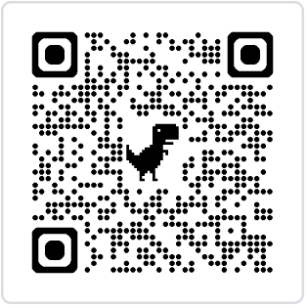

Github
Scan QR code to visit Repository

